Slide 1

Creating Software that Saves Lives
Intro to Spring MVC
Platinum Solutions Technology Conference
February 18, 2008
Reston, VA

Slide 2

About Spring MVC
Comes with the Spring distribution
Well integrated with the rest of Spring
Very extensible

Slide 3
Quick Spring Refresher
Write dependencies as setters
Link up dependencies in XML file
The Spring Framework will instantiate and call setters to hook it all together
<bean id=“dateFormat" class=“java.text.SimpleDateFormat">
<constructor-arg value=“dd MMM yyyy”/>
</bean>
<bean id=“myBean" class=“com.platinumSolutions.stuff.SomeClass">
<property name=“dateFormat” ref=“dateFormat”/>
</bean>

Slide 4
Spring MVC Basics
All calls go through the DispatcherServlet
Config file is *-servlet.xml by default
MVC: instances of the following:
  M – Model: a Java Map
  V – View: org.springframework.web.servlet.View
  C – Controller: org.springframework.web.servlet.mvc.Controller

Slide 5
Spring MVC Configuration
The configurable pieces of Spring MVC:
org.springframework.web.servlet.HandlerMapping
  what controller to call given a URL
org.springframework.web.servlet.ViewResolver
  how to determine what view to show
org.springframework.web.servlet.LocaleResolver
  how to determine internationalization
org.springframework.web.multipart.MultipartResolver
  how to handle uploaded files
org.springframework.web.servlet.HandlerExceptionResolver
  what to do with an Exception
org.springframework.web.servlet.ThemeResolver
  where to get css, images, pages from
org.springframework.web.servlet.HandlerAdapter
  wrapper around the controller (or servlet)

Slide 6
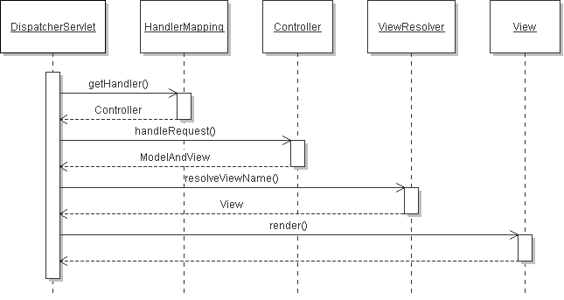
Spring MVC
A (simplified) sequence diagram:
Notes:
Show Example #1 - Simple Example

Slide 7
Handling the Request with a HandlerMapping
Given a URL, figures out what Controller to use:
SimpleUrlHandlerMapping
  define mappings with Map or Properties
BeanNameUrlHandlerMapping
  bean names have same names as URL
CommonsPathMapHandlerMapping
  use Commons Attributes to determine mapping
Notes:
Show example #2 - Using a HandlerMapping

Slide 8
Selecting a View with ViewResolver
Given a view name, figures out what View to use:
BeanNameViewResolver
  Spring beans happen to have the same name
UrlBasedViewResolver
  view name maps to a URL (like a filename)
ResourceBundleViewResolver
  look up the View in a resource file
XmlViewResolver
  uses XML file to determine mappings
FreeMarkerViewResolver
  UrlResourceViewResolver preset for FreeMarkerView
InternalResourceViewResolver
  UrlResourceViewResolver preset for InternalResourceView
VelocityViewResolver
  UrlResourceViewResolver preset for VelocityView
Notes:
Show Example #3 - Using a ViewResolver – Show the JUnit test

Slide 9
Different Views
Plenty of Views are packaged with Spring MVC:
JstlView
  map to a JSP page
RedirectView
  Perform an HTTP Redirect
TilesView, TilesJstlView
  integration with tiles
VelocityLayoutView, VelocityToolboxView, VelocityView
  Integration with the Velocity templating tool
FreeMarkerView
  use the FreeMarker templating tool
JasperReportsView, JasperReportsMultiFormatView, JasperReportsMultiFormatView, JasperReportsPdfView, JasperReportsXlsView
  Support for Jasper Reports
Notes:
Show Example #4 - Creating a custom view
Show Example #5 - Advanced ViewResolver (using a XmlViewResolver)

Slide 10
Localization
The locale may be chosen manually, selected by the browser, or fixed
  AcceptHeaderLocaleResolver - use the HTTP accept-header to determine the locale
  CookieLocalResolver - set the chosen locale in a cookie
  FixedLocaleResolver - always use a fixed locale (set in the config file)
  SessionLocaleResolver - store the chosen locale in the session
The spring tag <spring:message> picks the resource
Define the bean messageSource with a MessageSource to set the resources:
  StaticMessageSource - set messages within the object
  ResourceMessageBundleMessageSource - load messages from .properties files
  ReloadableResourceMessageBundleMessageSource - same as above, but reloads!
  (others)
Notes:
Show Example #6 – Localization with spring:message

Slide 11
Other Provided Controllers
Spring MVC includes lots of Controllers to extend from:
AbstractController
  basic controller, knows about caching, turning on/off get/set/post/head
ParameterizableViewController
  always go to the same view
UrlFileNameViewController
  parses the URL to return a view (http://blah/foo.html -> foo)
SimpleFormController
  for form handling, hooks for attaching commands, validator
AbstractWizardFormController
  easy wizard controller
ServletWrappingController
  delegates to a servlet

Slide 12
Handling Forms
Set the Command (just a bean)
Set a Validator if needed (extend org.springframework.validation.Validator)
Set destination views (form, success, failure, error)
By default, uses GET/POST to determine whether it needs to load the form or process it
Notes:
Show example 7 – The SimpleFormControlle
Show example #8 – The SimpleFormController with validations

Slide 13
Wizards
Similar to Forms, but needs to validate along the way
One Controller handles multiple pages
Process at the end
Cancel anywhere along the line
Spring Webflow is the now preferred

Slide 14
Interceptor
Some HandlerMappings allow you to call an interceptor before the controller
Useful for checking for session timeout, adding things to the request/session
Kind of like AOP, but for Controllers

Slide 15
ExceptionHandler
Spring philosophy says that most Exceptions should not be caught
ExceptionHandler determines what to do if an Exception is thrown through the Controller

Slide 16
Themes
Totally change look and feel of your application in one step!
Lets you point to different css, jsp, images

Slide 17
Conclusion
Spring MVC offers
  Lots of flexibility
  Straightforward design
  Leverages Spring injection

Slide 18
Resources
Websites
  www.springframework.org
Books
  Professional Java Development with the Spring Framework, Johnson, et al
  Pro Spring, Harrop & Machacek
  Spring: A Developer’s Notebook, Tate
  Spring in Action, Walls
  Expert Spring MVC and Web Flow, Ladd

Slide 19
Thank You!
www.PlatinumSolutions.com

